Slide 1
Installing Git
Ahmed Munieb Sheikh

Slide 2
Instructions
This is graded (2%) in-person activity and students must show the output to the TA during tutorial hours.
Duration of this activity is 45 minutes.
Follow the step-by-step instructions and connect with TA in case if you are getting any error/issues.

Slide 3
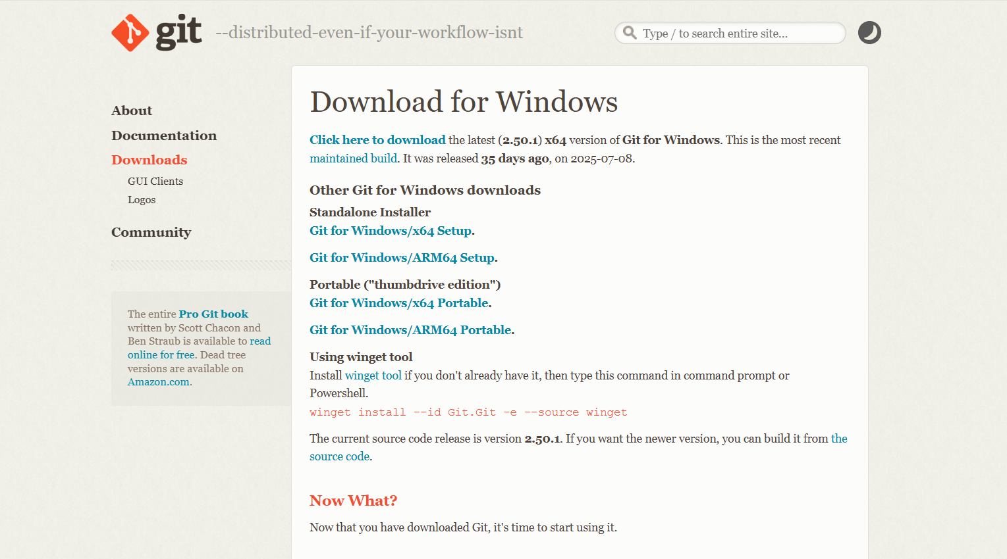
Installing Git
Installing on Windows
The most official build is available for download on the Git website. Just go to https://git-scm.com/download/win and the download will start automatically.

Slide 4
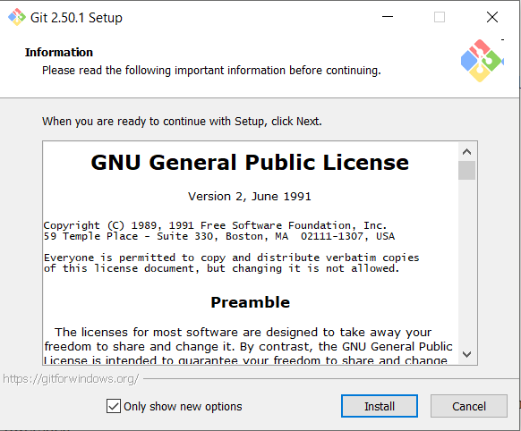
Installing Git (continued)

Slide 5
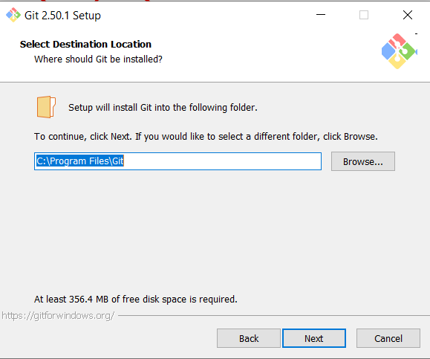
Installing Git (continued)

Slide 6
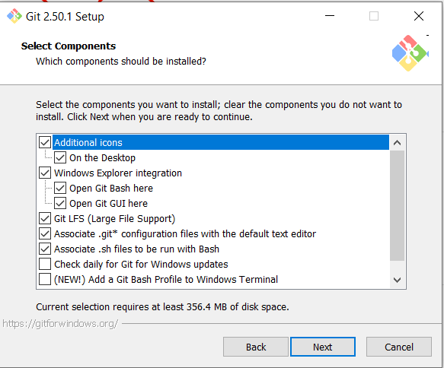
Installing Git (continued)

Slide 7
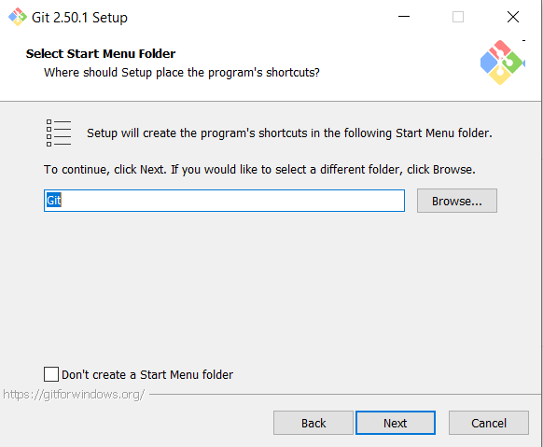
Installing Git (continued)

Slide 8
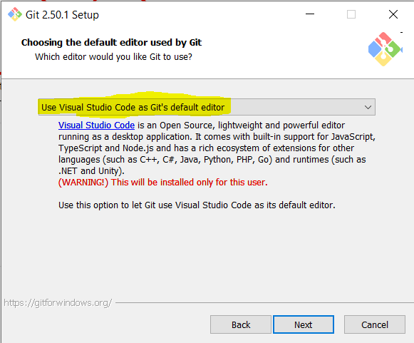
Installing Git (continued)

Slide 9
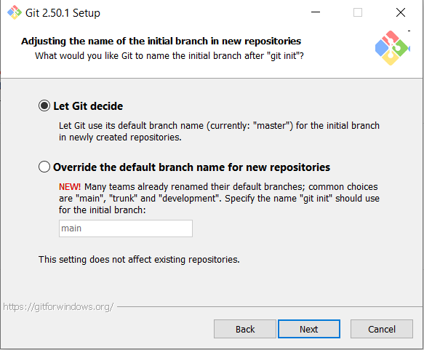
Installing Git (continued)

Slide 10
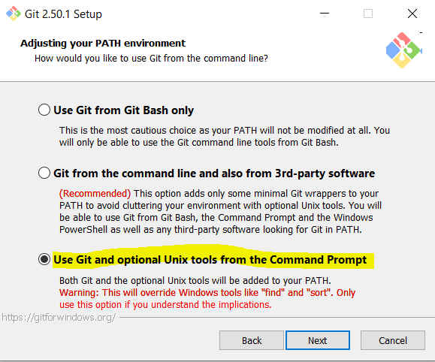
Installing Git (continued)

Slide 11
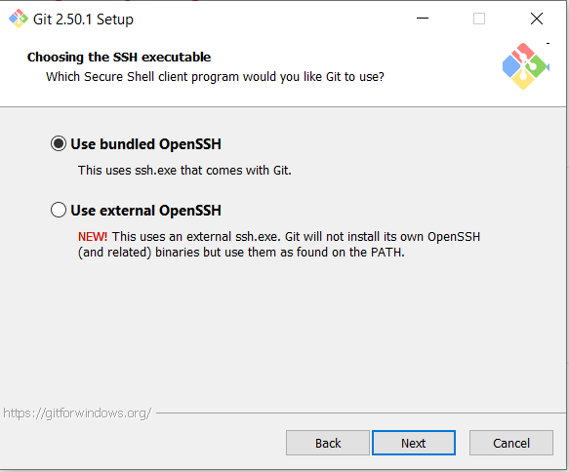
Installing Git (continued)

Slide 12
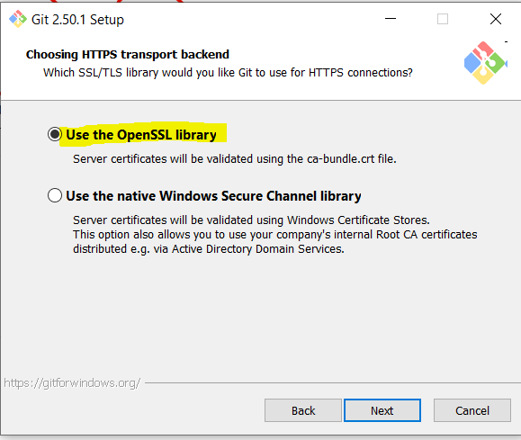
Installing Git (continued)

Slide 13
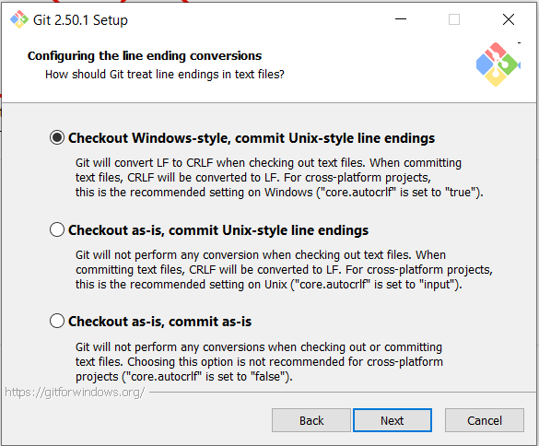
Installing Git (continued)

Slide 14
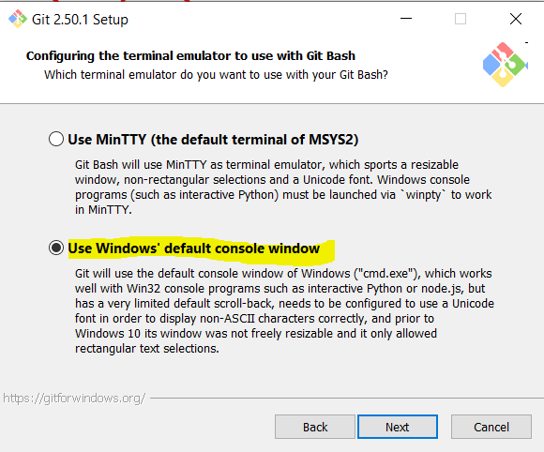
Installing Git (continued)

Slide 15
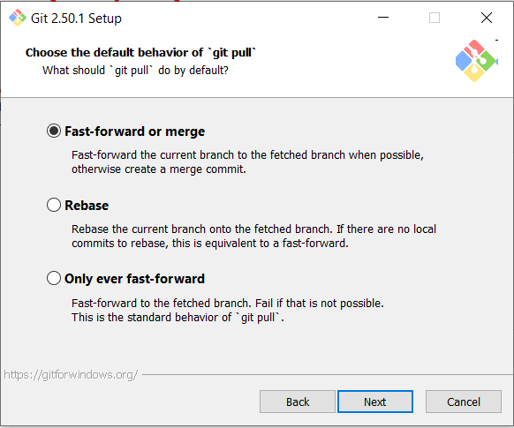
Installing Git (continued)

Slide 16
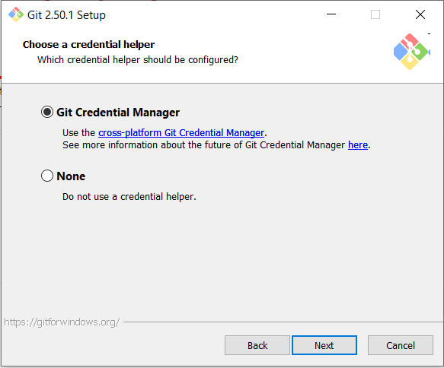
Installing Git (continued)

Slide 17
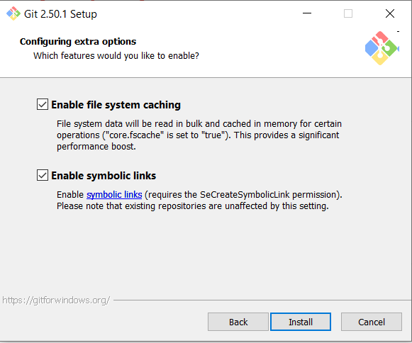
Installing Git (continued)

Slide 18
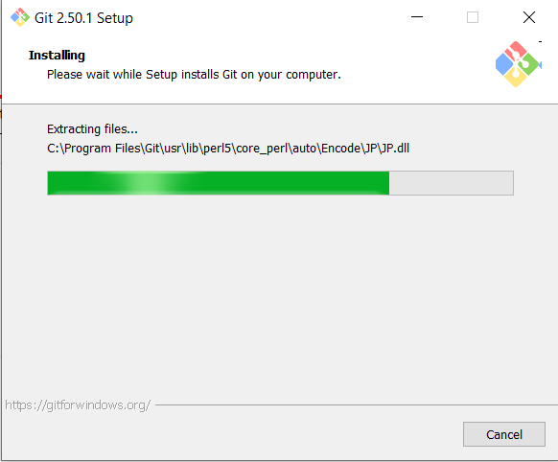
Installing Git (continued)

Slide 19
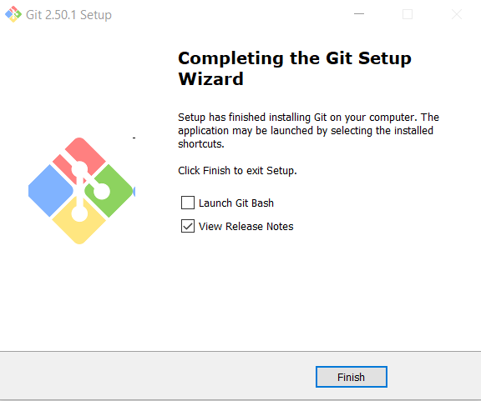
Installing Git (continued)

Slide 20
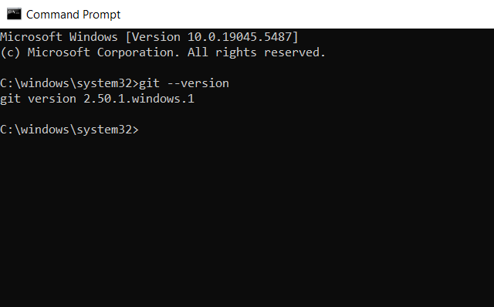
Installing Git (continued)
Verify your installation by opening a command prompt. Type cmd in search bar.
Enter the command: git --version and press enter

Slide 21
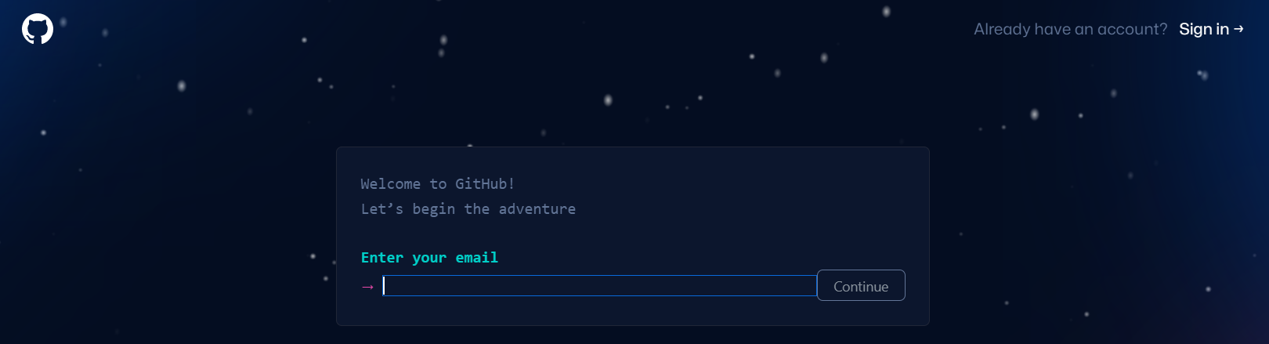
Setting up GitHub Account
Navigate to https://github.com/ , press the Sign up for GitHub button and enter your details:

Slide 22
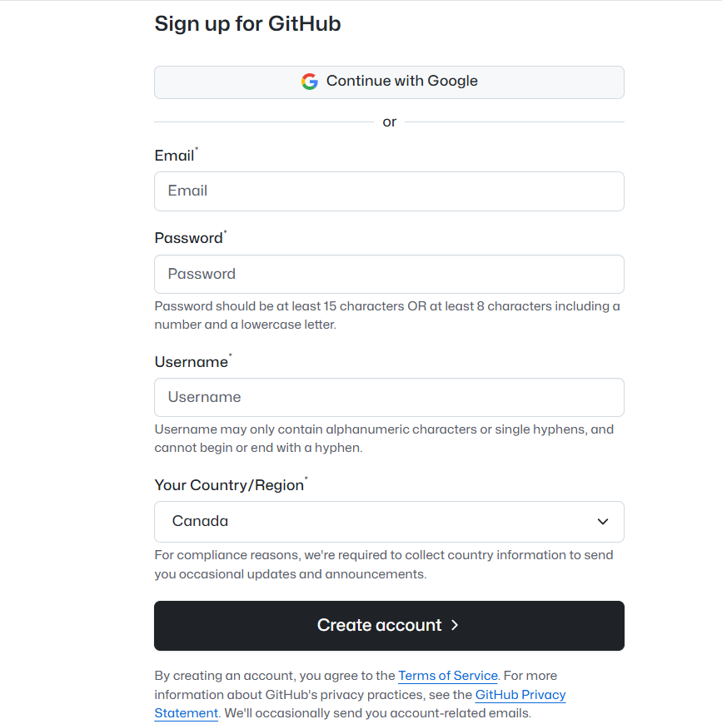
Setting up GitHub Account (cont.)
Enter your details or Continue with Google (I would recommend using your ontariotech.net account)
To confirm your identity, it will ask you for the code.

Slide 23
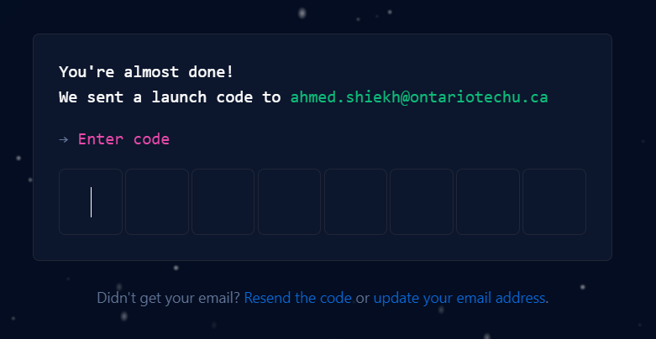
Setting up GitHub Account (cont.)

Slide 24
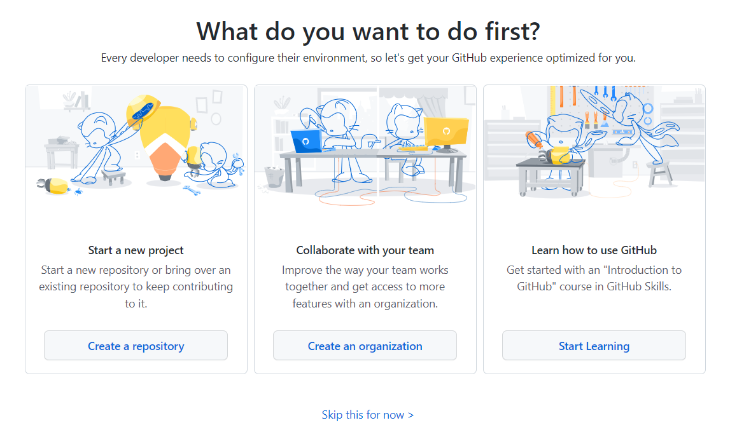
Creating new repository
After verifying your identity, on GitHub, you can start creating your repo by either clicking on the New button or Create a repository:

Slide 25
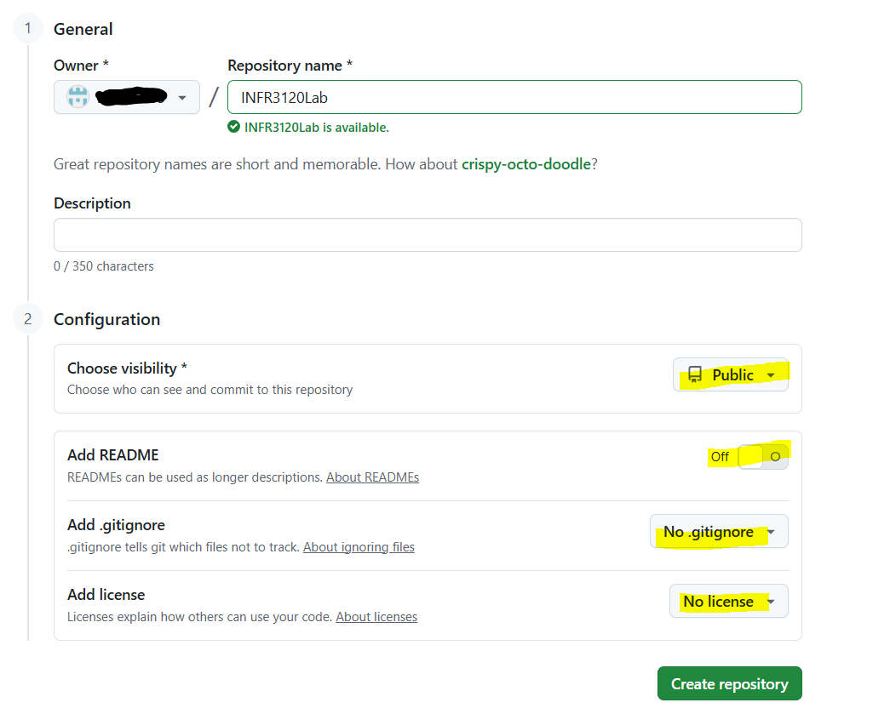
Creating new repository (continued)
My repository is named WebandScriptingProgramming, but students should create their own unique repository names. For now, the repository should remain public.

Slide 26
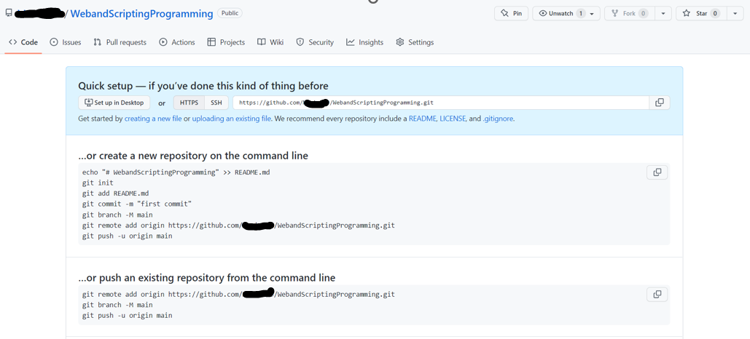
Creating new repository (continued)

Slide 27
Installing Git (continued)
Back to the windows, In the search bar now type Git Bash
The first thing you should do when you install Git is to set your username and email address.
This is important because every Git commit uses this information, and it’s immutably baked into the commits you start creating.
Open Git Bash and enter your information:
The email address and username you enter should be the same that you used to register for a new GitHub account.

Slide 28
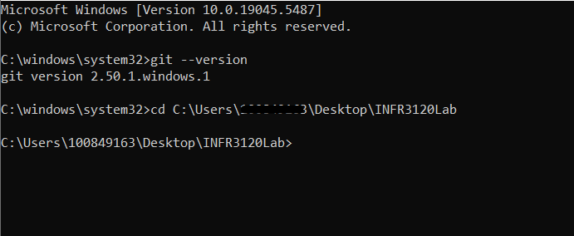
Git Configuration
Create a folder on Desktop, give it a name of your choice, in my case it’s INFR3120Lab.
Download sample file from CANVAS in this folder.
Now open command prompt using cmd in search bar.
Use cd command and move to the INFR3120Lab folder.

Slide 29
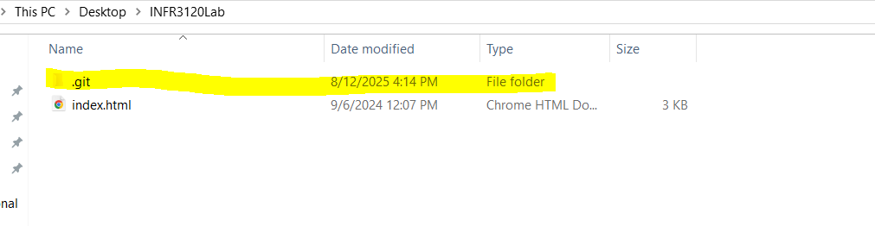
Git Configuration
Now type the following command:
git init
This will create this hidden .git folder in your folder.

Slide 30
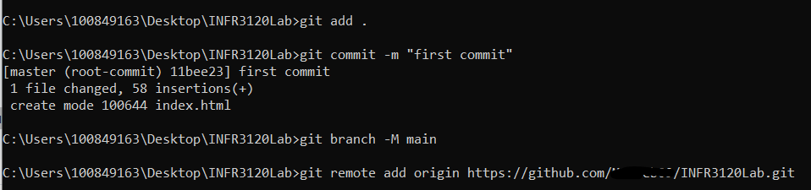
Git Configuration
Then run the command git add .
git commit –m “first commit”
git branch –M main
git remote add origin https://github.com/yourusername/INFR3120Lab.git

Slide 31
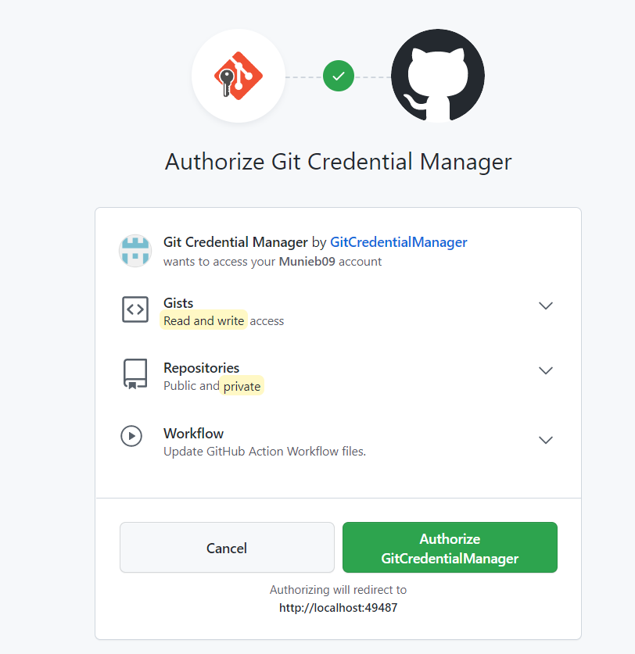
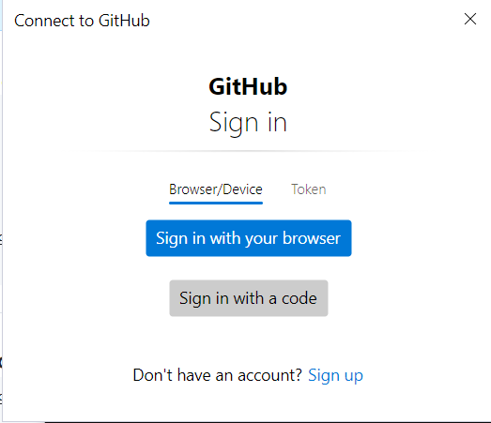
Authorize GitHub Account
Now in the cmd. enter the below command for authorization, with your username, user and repository name
git remote set-url origin https://yourusername@github.com/user/repo.git
Select the option of your choice and Authorize.

Slide 32
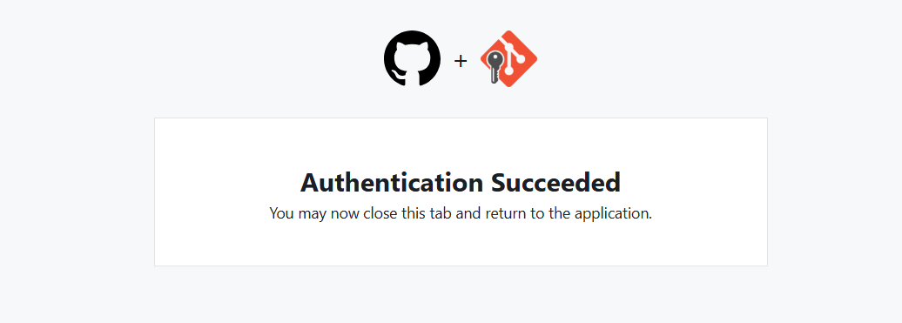
After verification you should be able to see the below screen:
After this enter the push command
git push –u origin master

Slide 33
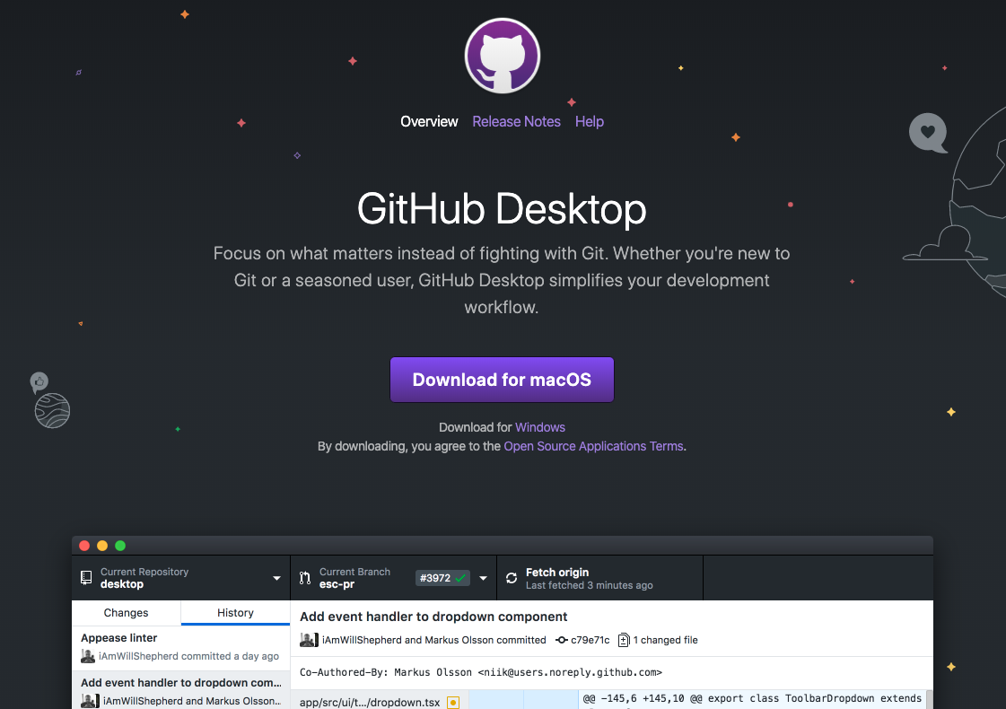
Common GUI Clients (continued)
GitHub Desktop: https://desktop.github.com/

